Slide 1

SCAN: Learning to Classify Images without Labels
Presenter: Michael Sidorov (M.Sc.)

Slide 2
Image Processing Goals
Recognize items within an image
Cluster similar objects together
Track items in frame
Interpret situations based on the items
etc.

Slide 3
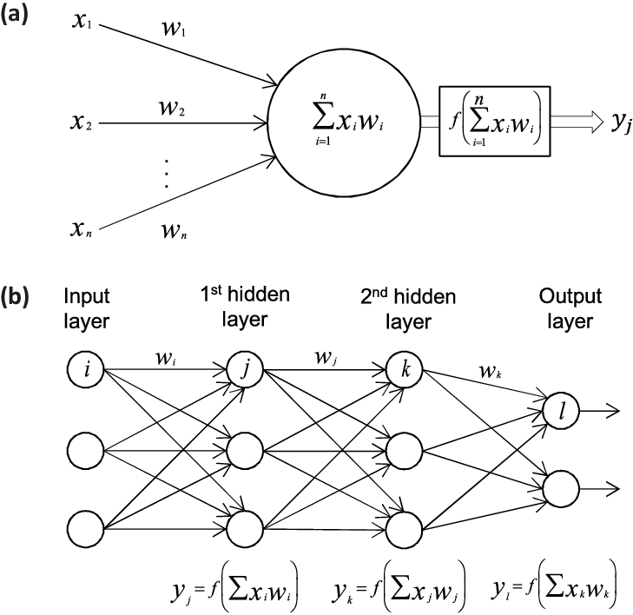
Neural Networks
A very basic (even too simplified to the verge of triviality) model of a neuron
Based on the idea of summation of signals to produce the required output
Training is performed in a forward-backward fashion
Suitable for a tabular data

Slide 4
Problems
Complexity (mainly when dealing with images)
Cost
Time

Slide 5

1) ConvNets
Assumes locality in space
Weight number is sub-exponential
Allow good generalization
Allow visualization of the process

Slide 6
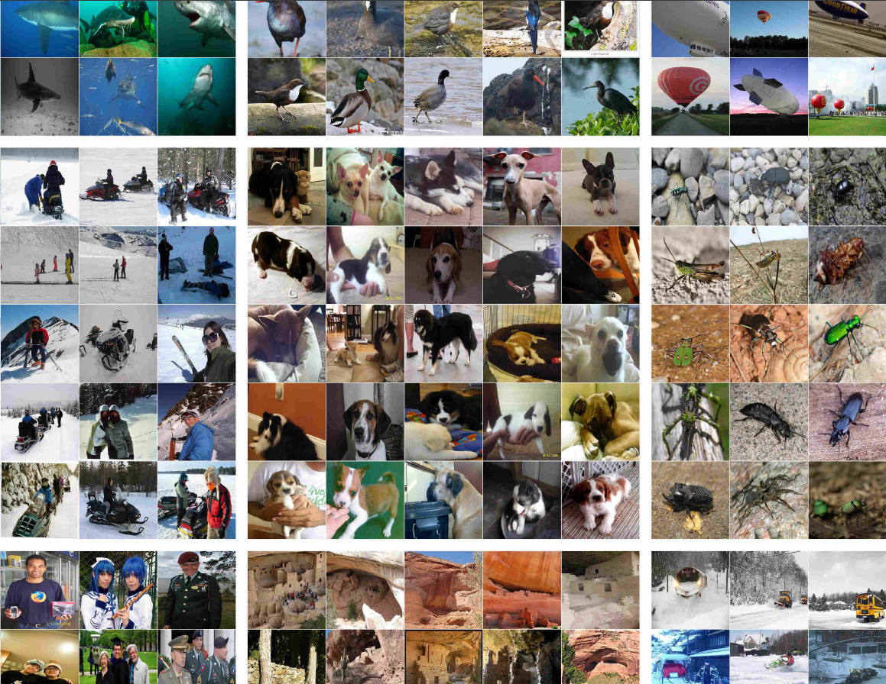
2, 3) SCAN Algorithm
Clusters images automatically
Assigns reliable lables to each cluster
Cuts the cost and alleviates the time required to achieve good clustering

Slide 7
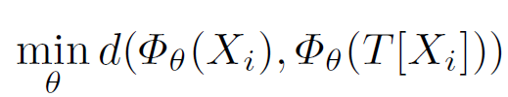
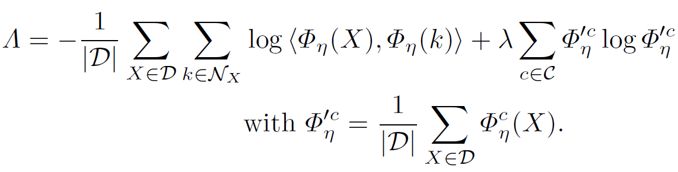
SCAN: Main Idea
Similar images should be similar after transformation is applied (i.e., in the latent space)
Similar images should belong to the same class in the latent space

Slide 8
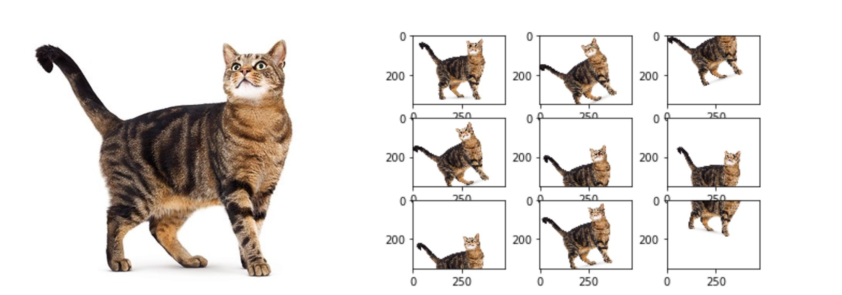
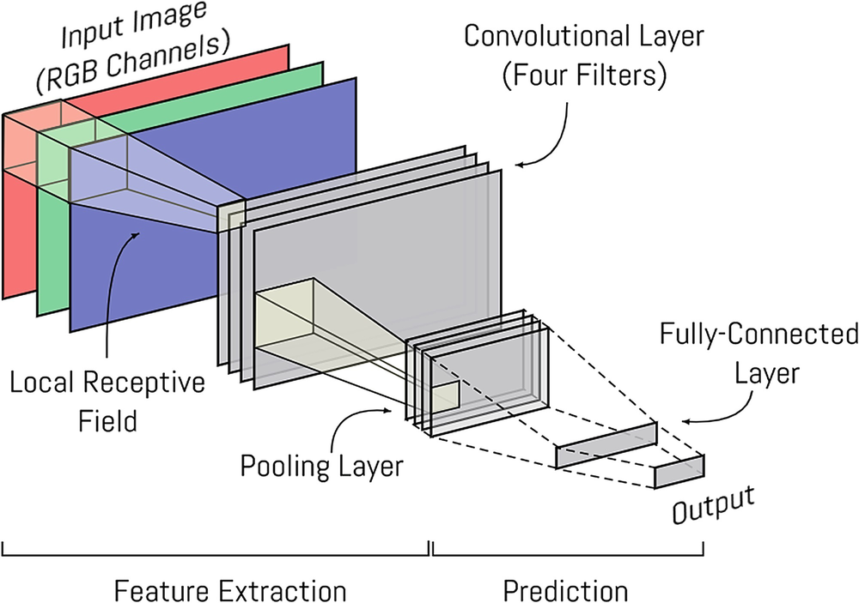

SCAN: Example
Latent Space ($Φ_{Θ}$)

Slide 9
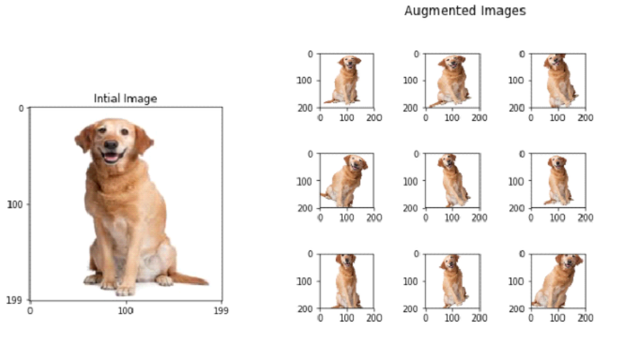

SCAN: Example (cont.)
Latent Space ($Φ_{Θ}$)
cat
dog
Label

Slide 10
Questions?

